Slide 1
How do convolutional neural networks work?

Slide 2
Convolutional neural networks are distinguished from other neural networks by their superior performance with image, speech, or audio signal inputs. They have three main types of layers, which are:
  Convolutional layer
  Pooling layer
  Fully-connected (FC) layer
The convolutional layer is the first layer while the FC layer is the last.
From the convolutional layer to the FC layer, the complexity of the CNN increases.
It is this increasing complexity that allows the CNN to successively identify larger portions and more complex features of an image until it finally identifies the object in its entirety.
i.e. Earlier layers focus on simple features, such as colors and edges. As the image data progresses through the layers of the CNN, it starts to recognize larger elements or shapes of the object until it finally identifies the intended object.

Slide 3
Convolutional layer.
The convolutional layer is the core building block of a CNN and the majority of computations happen in the convolutional layer.
A second convolutional layer can follow the initial convolutional layer.
It requires a few components, which are input data, a kernel/filter, and a feature map.
The process of convolution involves a kernel or filter inside this layer moving across the receptive fields of the image, checking if a feature is present in the image.

Slide 4
Over multiple iterations, the kernel sweeps over the entire image.
After each iteration a dot product is calculated between the input pixels and the filter.
The final output from the series of dots is known as a feature map or convolved feature.
Ultimately, the image is converted into numerical values in this layer, which allows the CNN to interpret the image and extract relevant patterns from it.

Slide 5
Example:
Assume the input is a color image, which is made up of a matrix of pixels in 3D.
This means that the input will have three dimensions—a height, width, and depth—which correspond to RGB in an image.
We also have a feature detector, also known as a kernel or a filter, which will move across the receptive fields of the image, checking if the feature is present. This process is known as a convolution.
The feature detector is a two-dimensional (2-D) array of weights, which represents part of the image.

Slide 6
While they can vary in size, the filter size is typically a 3x3 matrix; this also determines the size of the receptive field.
The filter is then applied to an area of the image, and a dot product is calculated between the input pixels and the filter.
This dot product is then fed into an output array.
Afterwards, the filter shifts by a stride, repeating the process until the kernel has swept across the entire image. The final output from the series of dot products from the input and the filter is known as a feature map, activation map, or a convolved feature.

Slide 7
The weights in the feature detector remain fixed as it moves across the image, which is also known as parameter sharing.
Some parameters, like the weight values, adjust during training through the process of backpropagation and gradient descent.
However, there are three hyper parameters which affect the volume size of the output that need to be set before the training of the neural network begins.
  Number of filters
  Stride
  Zero-padding

Slide 8
The number of filters affects the depth of the output. For example, three distinct filters would yield three different feature maps, creating a depth of three.
Stride is the distance, or number of pixels, that the kernel moves over the input matrix. While stride values of two or greater is rare, a larger stride yields a smaller output.
Zero-padding is usually used when the filters do not fit the input image. This sets all elements that fall outside of the input matrix to zero, producing a larger or equally sized output.

Slide 9
Input: n X n
Padding: p
Filter size: f X f
Output: (n+2p-f+1) X (n+2p-f+1)
There are three types of padding:
  Valid padding: This is also known as no padding. In this case, the last convolution is dropped if dimensions do not align - (n-f+1) X (n-f+1)
  Same padding: This padding ensures that the output layer has the same size as the input layer - n+2p-f+1 = n; so p = (f-1)/2
  Full padding: This type of padding increases the size of the output by adding zeros to the border of the input.

Slide 10
After each convolution operation, a CNN applies a Rectified Linear Unit (ReLU) transformation to the feature map, introducing nonlinearity to the model.
Additional convolutional layer: another convolution layer can follow the initial convolution layer
When this happens, the structure of the CNN can become hierarchical as the later layers can see the pixels within the receptive fields of prior layers.
Ultimately, the convolutional layer converts the image into numerical values, allowing the neural network to interpret and extract relevant patterns.

Slide 11
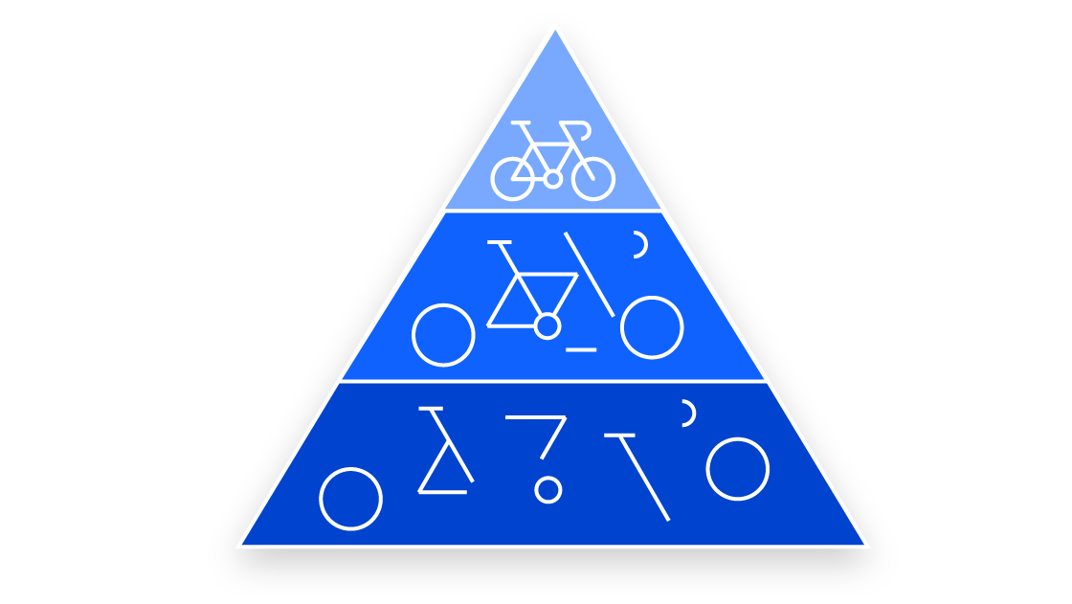

Slide 12
Pooling layer
Pooling layers, also known as downsampling, conducts dimensionality reduction, reducing the number of parameters in the input.
Similar to the convolutional layer, the pooling operation sweeps a filter across the entire input, but the difference is that this filter does not have any weights.
Instead, the kernel applies an aggregation function to the values within the receptive field, populating the output array.
While a lot of information is lost in the pooling layer, it also has a number of benefits to the CNN. They help to reduce complexity, improve efficiency, and limit risk of overfitting.

Slide 13
Types of pooling
There are two main types of pooling:
Max pooling: As the filter moves across the input, it selects the pixel with the maximum value to send to the output array. As an aside, this approach tends to be used more often compared to average pooling.
Average pooling: As the filter moves across the input, it calculates the average value within the receptive field to send to the output array.

Slide 14


Slide 15
Fully-connected layer
In the fully-connected layer, each node in the output layer connects directly to a node in the previous layer.
Whereas in partially connected layers, the pixel values of the input image are not directly connected to the output layer.
This layer performs the task of classification based on the features extracted through the previous layers and their different filters.
While convolutional and pooling layers tend to use ReLu functions, FC layers usually leverage a softmax activation function to classify inputs appropriately, producing a probability from 0 to 1.

Slide 16
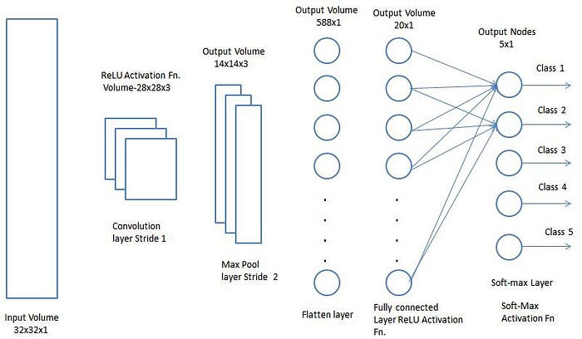

Slide 17
Once the input image is converted into a suitable form for the Multi-Level Perceptron, then the image is flatten into a column vector. The flattened output is fed to a feed-forward neural network and backpropagation is applied to every iteration of training.
Over a series of epochs, the model is able to distinguish between dominating and certain low-level features in images and classify them using the Softmax Classification technique.

Slide 18
Various CNN Architectures

Slide 19
LeNet
LeNet is a pioneering CNN designed for recognizing handwritten characters. It was proposed by Yann LeCun, Leon Bottou, Yoshua Bengio, and Patrick Haffner in the late 1990s.
LeNet consists of a series of convolutional and pooling layers, as well as a fully connected layer and softmax classifier.
It was among the first successful applications of deep learning for computer vision. It has been used by banks to identify numbers written on cheques in grayscale input images.

Slide 20
AlexNet
AlexNet won the ImageNet Large Scale Visual Recognition Challenge (ILSVRC) in 2012, with a significant margin of error reduction compared to the previous state-of-the-art model – down to 15% from 26%. It was designed by Alex Krizhevsky, Ilya Sutskever, and Geoffrey Hinton at the University of Toronto.
AlexNet consists of five convolutional layers with max pooling, and three FC layers, with ReLU activation functions used throughout. In addition to 3×3 filters, it also has 5×5 and 11×11 convolutional filters.
The network uses a dropout technique to reduce overfitting, and employs data augmentation methods to increase the effective size of the training set. AlexNet’s success demonstrated the power of deep learning methods in computer vision and led to a surge of interest in the field. It also popularized the use of GPUs for accelerating the training of deep neural networks.

Slide 21
VGGNet
VGG (Visual Geometry Group) is a research group within the Department of Engineering Science at the University of Oxford. The VGG group is well-known for its work in computer vision, particularly in the area of convolutional neural networks (CNNs).
One of the most famous contributions from the VGG group is the VGG model, also known as VGGNet. The VGG model is a deep neural network that achieved state-of-the-art performance on the ImageNet Large Scale Visual Recognition Challenge in 2014, and has been widely used as a benchmark for image classification and object detection tasks.
The VGG model is characterized by its use of small convolutional filters (3×3) and deep architecture (up to 19 layers), which enables it to learn increasingly complex features from input images. The VGG model also uses max pooling layers to reduce the spatial resolution of the feature maps and increase the receptive field, which can improve its ability to recognize objects of varying scales and orientations.
The VGG model has inspired many subsequent research efforts in deep learning, including the development of even deeper neural networks and the use of residual connections to improve gradient flow and training stability.

Slide 22
GoogLeNet
GoogLeNet is a deep convolutional neural network developed by researchers at Google. It was introduced in 2014 and won the ILSVRC (ImageNet Large-Scale Visual Recognition Challenge) that year, with a top-five error rate of 6.67%.
GoogLeNet is notable for its use of the Inception module, which consists of multiple parallel convolutional layers with different filter sizes, followed by a pooling layer, and concatenation of the outputs. This design allows the network to learn features at multiple scales and resolutions, while keeping the computational cost manageable. The network also includes auxiliary classifiers at intermediate layers, which encourage the network to learn more discriminative features and prevent overfitting.
GoogLeNet builds upon the ideas of previous convolutional neural networks, including LeNet, which was one of the first successful applications of deep learning in computer vision. However, GoogLeNet is much deeper and more complex than LeNet.

Slide 23
ResNet
ResNet (short for “Residual Neural Network”) is a family of deep convolutional neural networks designed to overcome the problem of vanishing gradients that are common in very deep networks. The idea behind ResNet is to use “residual blocks” that allow for the direct propagation of gradients through the network, enabling the training of very deep networks.
A residual block consists of two or more convolutional layers followed by an activation function, combined with a shortcut connection that bypasses the convolutional layers and adds the original input directly to the output of the convolutional layers after the activation function.
This allows the network to learn residual functions that represent the difference between the convolutional layers’ input and output, rather than trying to learn the entire mapping directly. The use of residual blocks enables the training of very deep networks, with hundreds or thousands of layers, significantly alleviating the issue of vanishing gradients.

Slide 24
R-CNN
R-CNN (Region-based Convolutional Neural Network) was introduced in 2013, and is a two-stage approach to object detection.
First, the input image is segmented into regions of interest (ROIs) using selective search, a computationally expensive algorithm that generates region proposals based on image texture, color, and other features. Then, each ROI is passed through a CNN that produces a fixed-length feature vector. The CNN used in R-CNN is usually a pretrained network, such as AlexNet or VGG.
These feature vectors are used to classify the object contained in the ROI and predict its bounding box coordinates. While R-CNN achieved cutting-edge results at the time, it was very slow to train and test, due to the need to process thousands of region proposals for each image.
R-CNN is part of a series of object detection models, alongside Fast R-CNN and Faster R-CNN, which were developed by researchers at UC Berkeley and Microsoft Research, and represent a significant improvement over earlier methods for object detection.

Slide 25
Fast R-CNN
Fast R-CNN, introduced in 2015, improved on R-CNN by eliminating the need for a separate feature extraction step for each region proposal. Instead, the entire image is passed through the CNN, producing a feature map that is shared by all the region proposals. Each ROI is then pooled into a feature map with a fixed size through an operation called “Region of Interest (ROI) Pooling”, and passed through a sequence of FC layers to produce the final bounding box and classification predictions.
This approach is much faster and more accurate than R-CNN, and also allows for end-to-end training of the entire model.

Slide 26
Faster R-CNN
Faster R-CNN, introduced in 2015, further improved on Fast R-CNN by replacing selective search with an RPN (Region Proposal Network), which is a small convolutional network that generates region proposals directly from the feature map produced by the CNN. The RPN shares the same convolutional layers as the object detection network, making the entire model more efficient and easier to train.
The RPN predicts objectness scores and bounding box coordinates for each anchor point in the feature map, and these proposals are then refined and classified by the object detection network. This approach is even faster and more accurate than Fast R-CNN, and has become the de facto standard for object detection in many applications.

Slide 27
Random or Unsupervised Features
The most expensive part of convolutional network training is learning the features.
The output layer is usually relatively inexpensive due to the small number of features provided as input to this layer after passing through several layers of pooling.
When performing supervised training with gradient descent, every gradient step requires a complete run of forward propagation and backward propagation through the entire network.
One way to reduce the cost of convolutional network training is to use features that are not trained in a supervised fashion.

Slide 28
There are three basic strategies for obtaining convolution kernels without supervised training.
  To simply initialize them randomly.
  To design them by hand, for example by setting each kernel to detect edges at a certain orientation or scale.
  Learning the kernels with an unsupervised criterion, for example, Coates et al. (2011) apply k-means clustering to small image patches, then use each learned centroid as a convolution kernel.
Learning the features with an unsupervised criterion allows them to be determined separately from the classifier layer at the top of the architecture.
One can then extract the features for the entire training set just once, essentially constructing a new training set for the last layer.
Learning the last layer is then typically a convex optimization problem, assuming the last layer is something like logistic regression or an SVM.
Today, most convolutional networks are trained in a purely supervised fashion, using full forward and back-propagation through the entire network on each training iteration.

